Slide 1
BIKE STORE ANALYSIS
USING MYSQL BY DHANUSHPRIYA

Slide 2
OBJECTIVE
Analyze sales data to identify trends in product performance.
Regional preferences to make informed inventory and marketing decisions.
Explore customer purchase patterns, segmentations using advance concepts of sql

Slide 3
DATA SOURCE Data analysis at kaggle.com (http://kaggle.io/dataanalysis?bikestore .csv) I download data set from kaggle.com.

Slide 4
Data cleaning and preprocessing: Creating a database, setting up tables, and importing data. Let’s navigate to our MYSQL, where we’ll create a database. Simply right-click and name it as “bikestore_analysis ”.
create database bikestore;use bikestore;

Slide 5
Import and Observe data sets
Using this command we can observe our data sets
Desc orders;
Desc cusomers;
Desc products;
Desc order_items;
We have choosen six tables in the dataset they were orders table,customers table,products table,orderitmes ,categories,stores table.

Slide 6
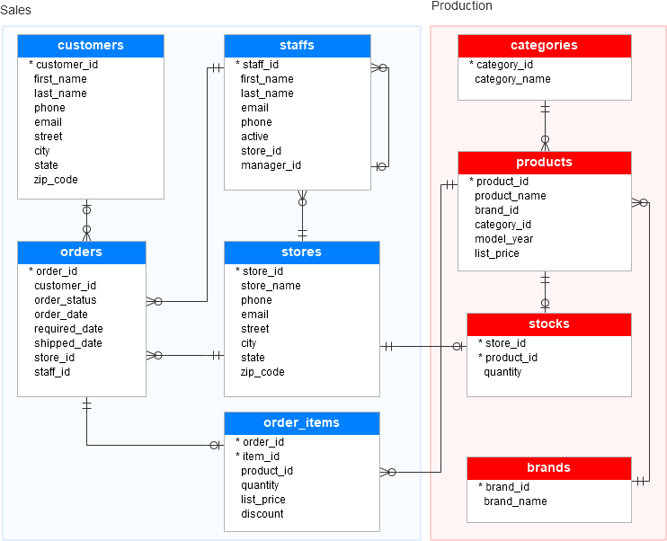
Tables and there attributes in the dataset

Slide 7



OBSERVATION ON DATASETS
total orders
total products
total customers
select count(order_id) as totalorders from orders;
select count(product_id) as totalproducts from products;
select count(customer_id) as totalcustomer from customers;

Slide 8
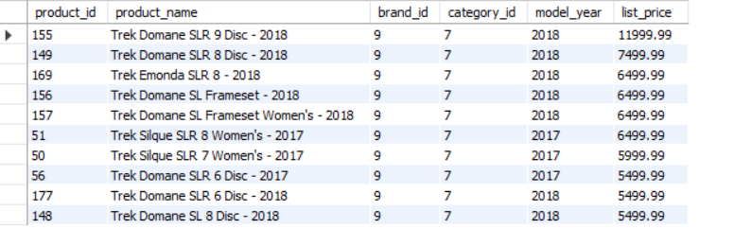
Product analysis top 10 most expensive bikes
select * from products order by list_price desc limit 10;
In this observation over the 321 product these 10 product are most expencive bikes.

Slide 9
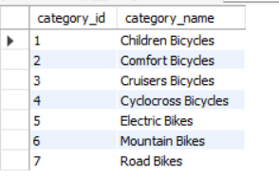
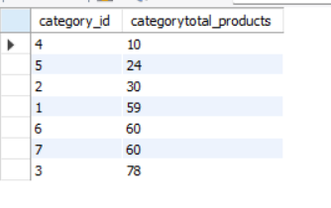
how many bikes in each category ?
select p1.category_id, count(product_id) as categorytotal_products from products p1 group by p1.category_id order by categorytotal_products ;
In this observation I have conclude that each category had more than 10 models and cruisers bicycle which is category_id 3 had highest models 78.we conclude that using group by ond order by functions.

Slide 10
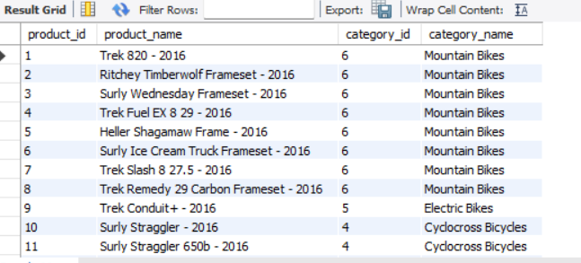
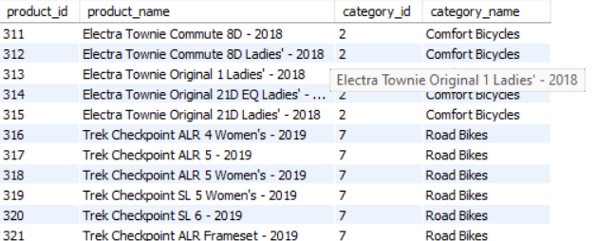
view the product name and category id with category name
select p1.product_id,p1.product_name,p1.category_id,c1.category_name from products p1 left join categories c1 on p1.category_id=c1.category_id;
Using left join I joined the two tables which are product table and categories table to view the product name with categories name.

Slide 11
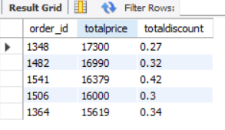
Sales analysis most expencive orders with thier discount 5
select ot.order_id, round(sum(list_price))as totalprice,sum(discount) as totaldiscount from order_items ot group by order_id order by totalprice desc limit 5;
Order id 1348,1482,1541,1506,1364 are the top 5 orders and their discount is shown.

Slide 12
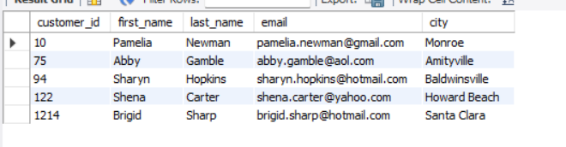
Top 5 customers who purchased highest price
select c.customer_id,c.first_name,c.last_name,c.email,c.city from customers c join orders o on c.customer_id = o.customer_id where order_id in ('1348','1482','1541','1506','1364');
Using joins we join the order table and customer table and we found top 5 customers who ordered highest amount.

Slide 13
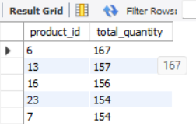
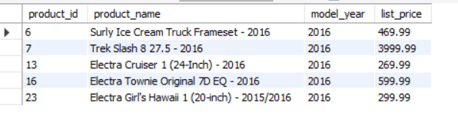
top 5 good selling product
select ot.product_id, sum(quantity) as total_quantity from order_items ot group by product_id order by total_quantity desc limit 5;
select p.product_id,p.product_name,p.model_year,p.list_price from products p where product_id in ('6' ,'13','16','23','7');
Result grid one shows that product id and their selling quantity and result grid two shows that product name and their list price.

Slide 14
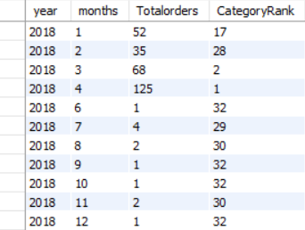
View the total orders by monthly and yearly wise
CREATE VIEW Monthly_orders AS SELECT EXTRACT(YEAR FROM Order_Date) AS year, EXTRACT(MONTH FROM Order_Date) AS months, count(Order_ID) AS Totalorders,RANK() OVER (ORDER BY count(order_id)DESC) AS CategoryRank FROM orders GROUP BY year, months ORDER BY year, months ;
In this observation I use extract fuction to extract the months and years from orderdate and rank function to give rank to count of the orders.we can get month and year wise total orders.
SELECT *FROM Monthly_orders;

Slide 15
Thank you

